Slide 1
Evolutionary neural networks
By Daniel Sklyarevskiy

Slide 2
TABLE OF CONTENTS
01.
02.
03.
NEURAL networks 101
Evolutionary neural networks
NEAT-python
04.
05.
06.
Example code
Application for game
REAL LIFE USES

Slide 3
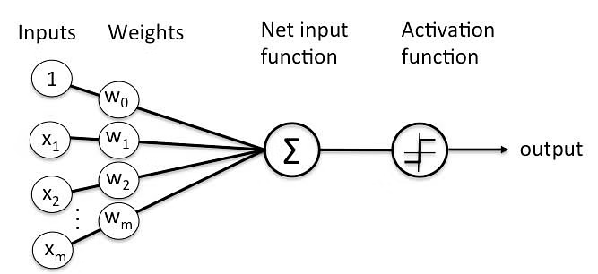
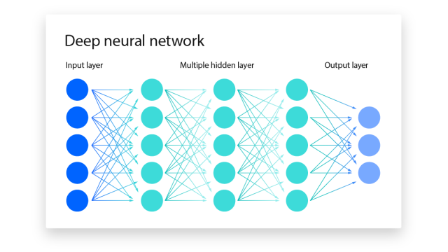
NEURAL NETWORkS 101
Neural networks are a form of artificial intelligence inspired by a model of the human brain
A neural network is made up of units called perceptrons, each one of which takes in multiple weighted inputs and returns a result
A neural network consists of multiple layers of these perceptrons, all of which eventually culminate in an ‘output layer’ with concrete results to the problem at hand

Slide 4
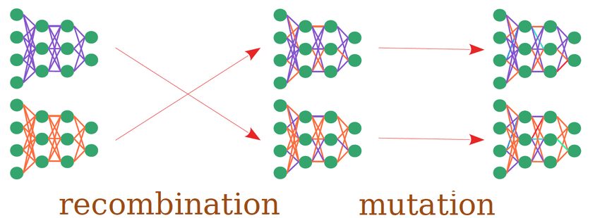
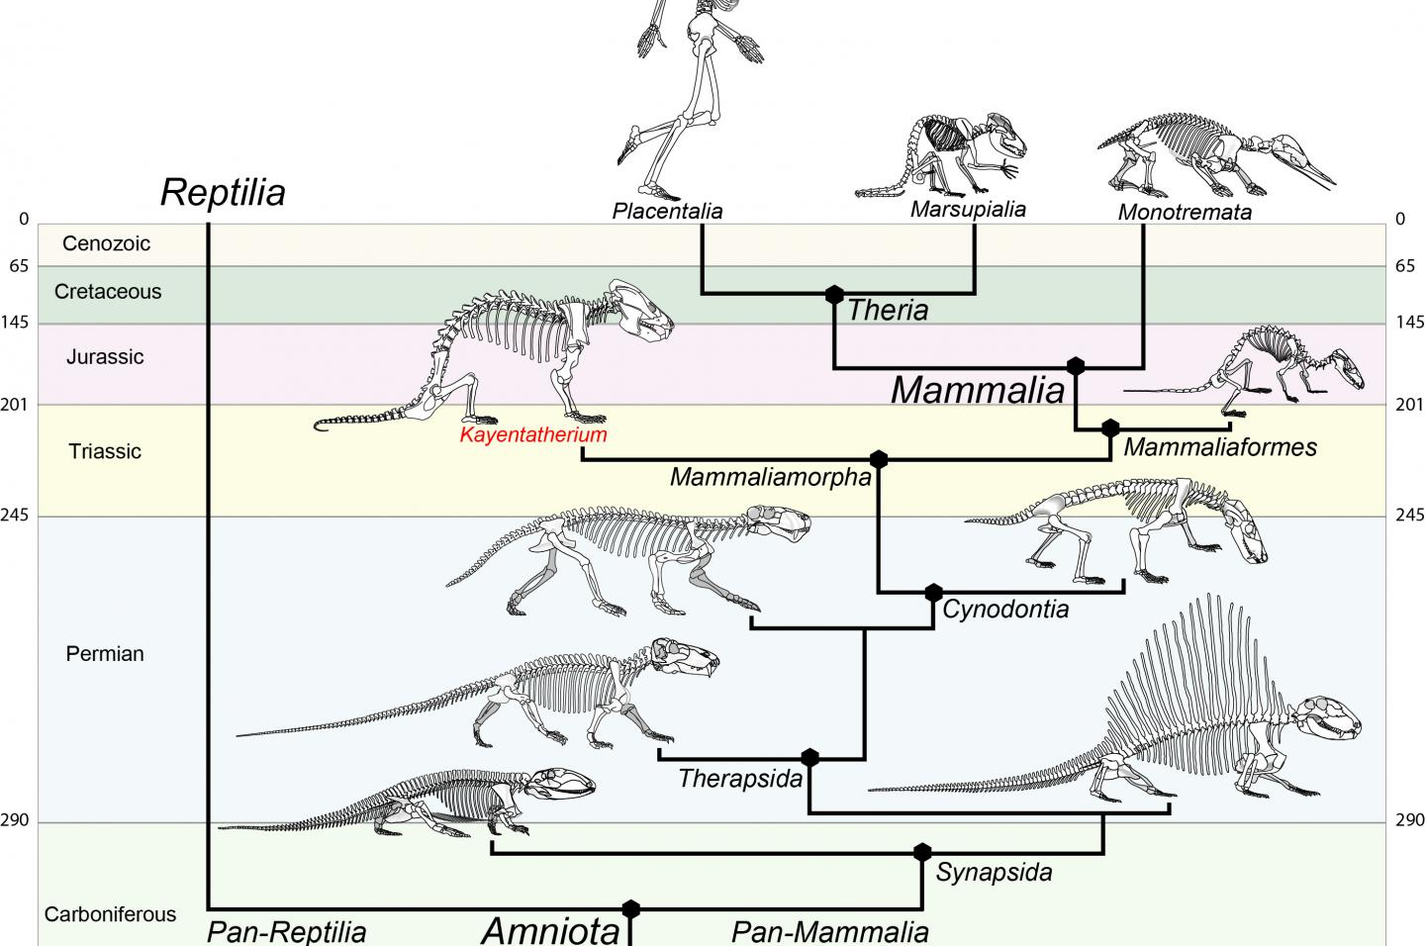
EVOLUTIONARY NEURAL NETWORkS
What sets evolutionary neural networks apart from deep learning is the way weights are adjusted
Deep networks update weights by calculating contribution to the loss
Evolutionary algorithms have more randomized weights through combining values from multiple trained networks, and slightly modifying random aspects
This type of neural network is designed to mimic real world evolution

Slide 5
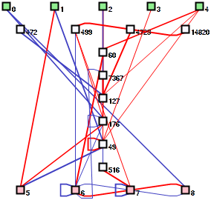
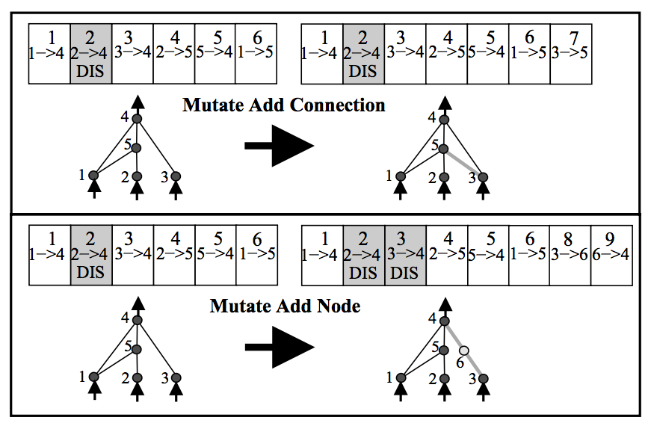
NEAT-python
NEAT-PYTHON is a python library designed to streamline the process of creating an evolutionary neural network
The library allows you to define the inputs and weights for the original perceptron layer, and use those to train AI in your python projects
Details such as the amount of generations, recombinations, and minimum score for success can be specified in the config.txt file
NEAT is predominantly used for creation of game ai, but has a lot of other potential uses that I will touch on later

Slide 6
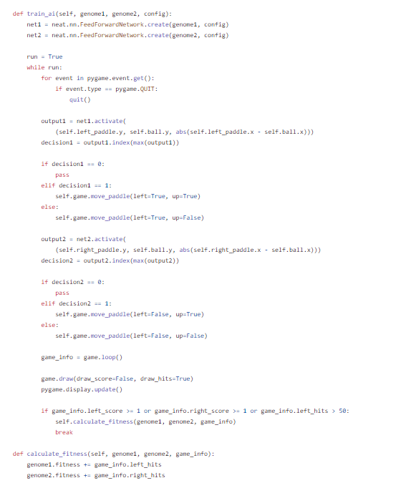
EXAMPLE CODE
This snippet of code shows the methodology behind training an AI to play Pong using NEAT
The paddles are trained by playing against each other, with the inputs being modified as part of the evolutionary neural network
Training paddles in this way allows for more eventual variety than given by that of a standard deep learning network

Slide 7
Application for game
The game shown is a very simple program where the player controls a character that has to collect coins without touching the edges
Similarly to the pong example, I am planning to add a second character and train them playing against each other, randomly combining the results
Although the game is inherently random (with the coin positions), I believe that the trained AI would be able to beat a human significantly more often than 50% of the time if trained correctly

Slide 8
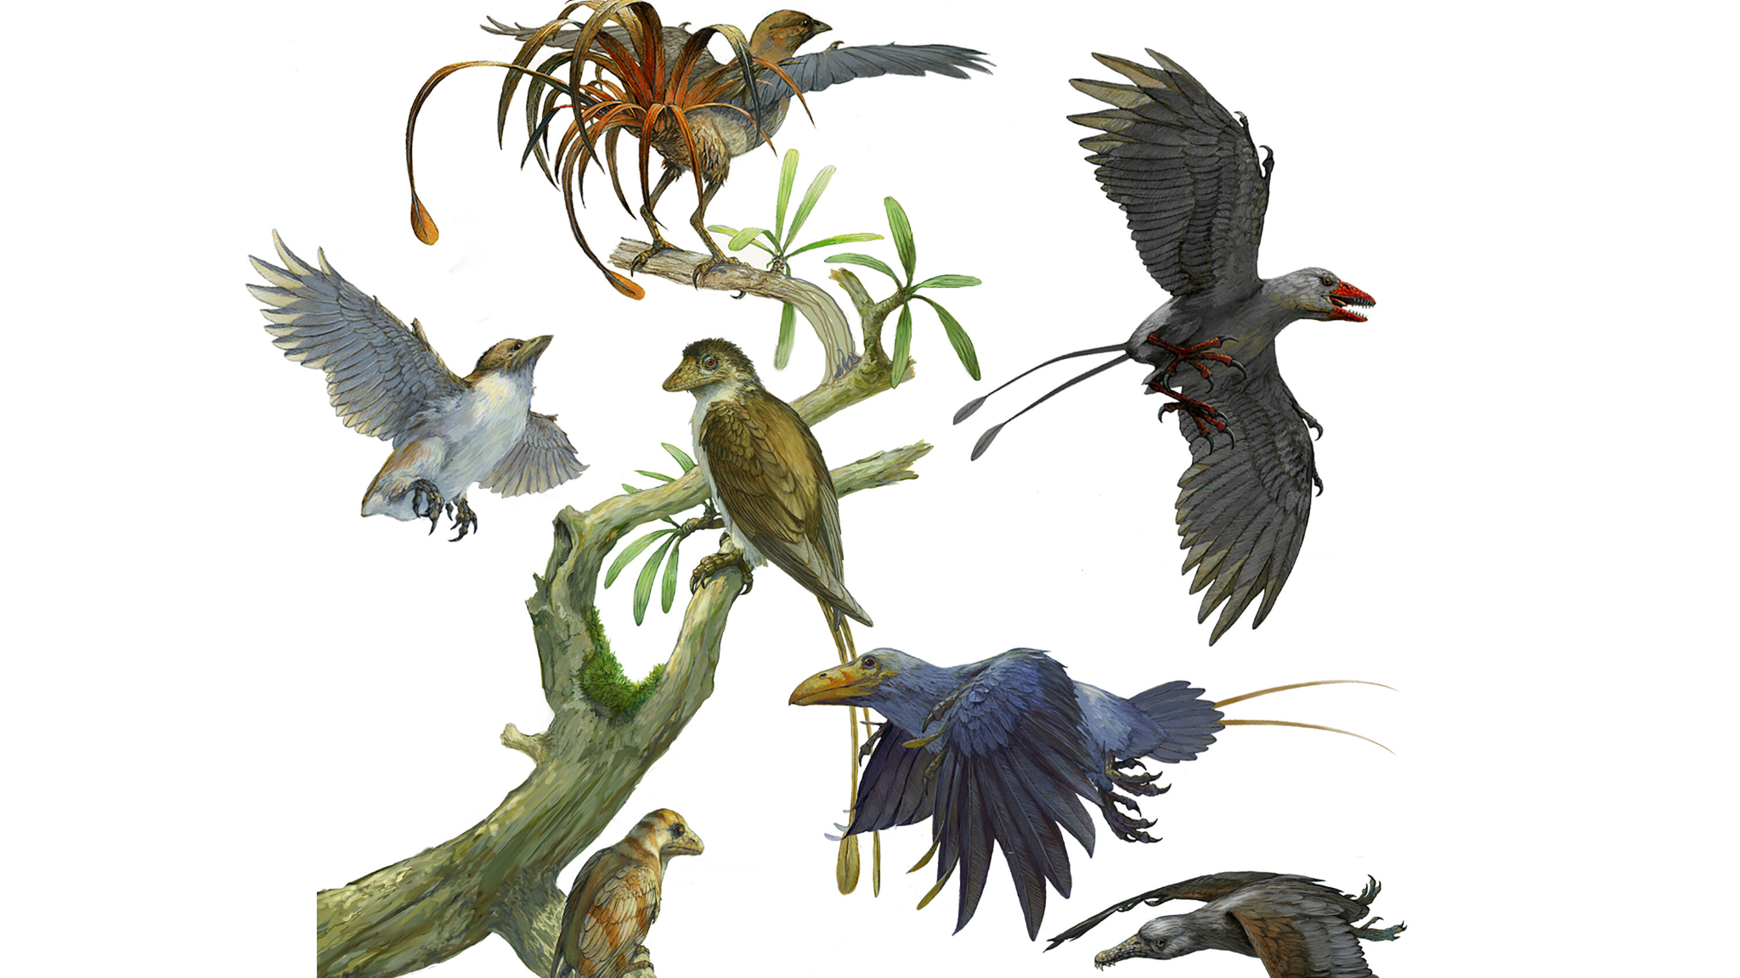
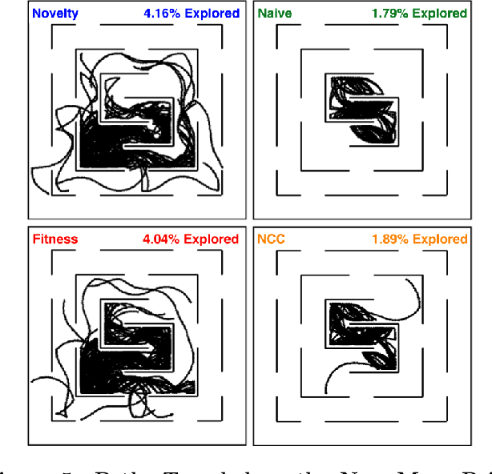
REAL LIFE USES
Outside of game development, NEAT is best used instead of deep learning if the problem at hand doesn’t have a clear objective function (or dynamic problems)
Although not fully tested yet, this approach could be particularly useful for predicting changes that take place over thousands of years, such as the evolution of a particular species due to deforestation
Another use would be to find an outcome that’s hard to measure, such as the ‘novelty’ of a certain idea

